Slide 1
Federal Election Commision & eRegs
WHODIS? It’s 18F. Bringin’ da data funk.
White House Open Data Initiative Summit 9/28/2016
eRegulations

Slide 2
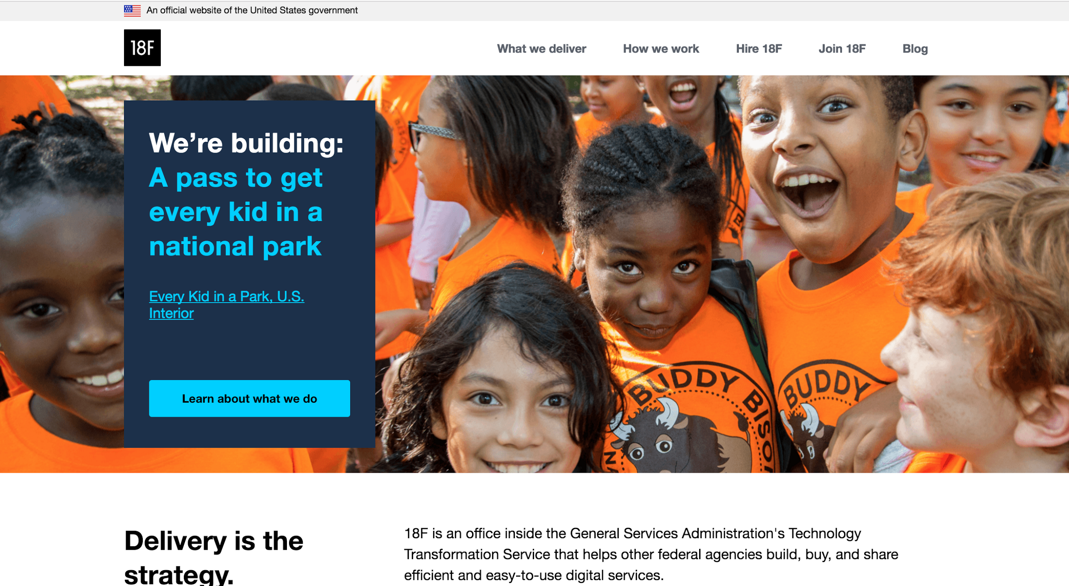

Slide 3
Federal Election Commission
Open Data
Lindsay Young, 18F

Slide 4
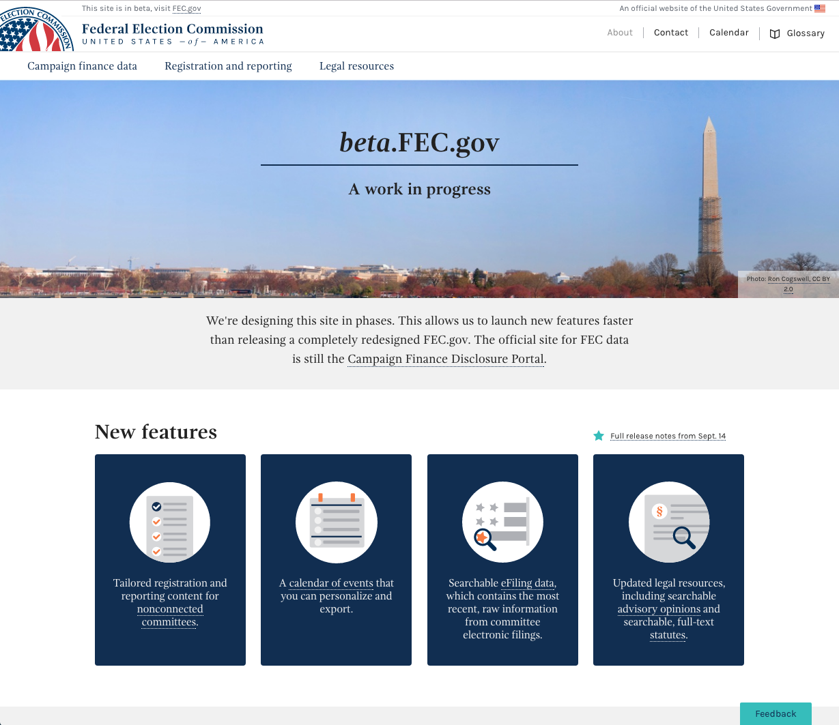

Slide 5
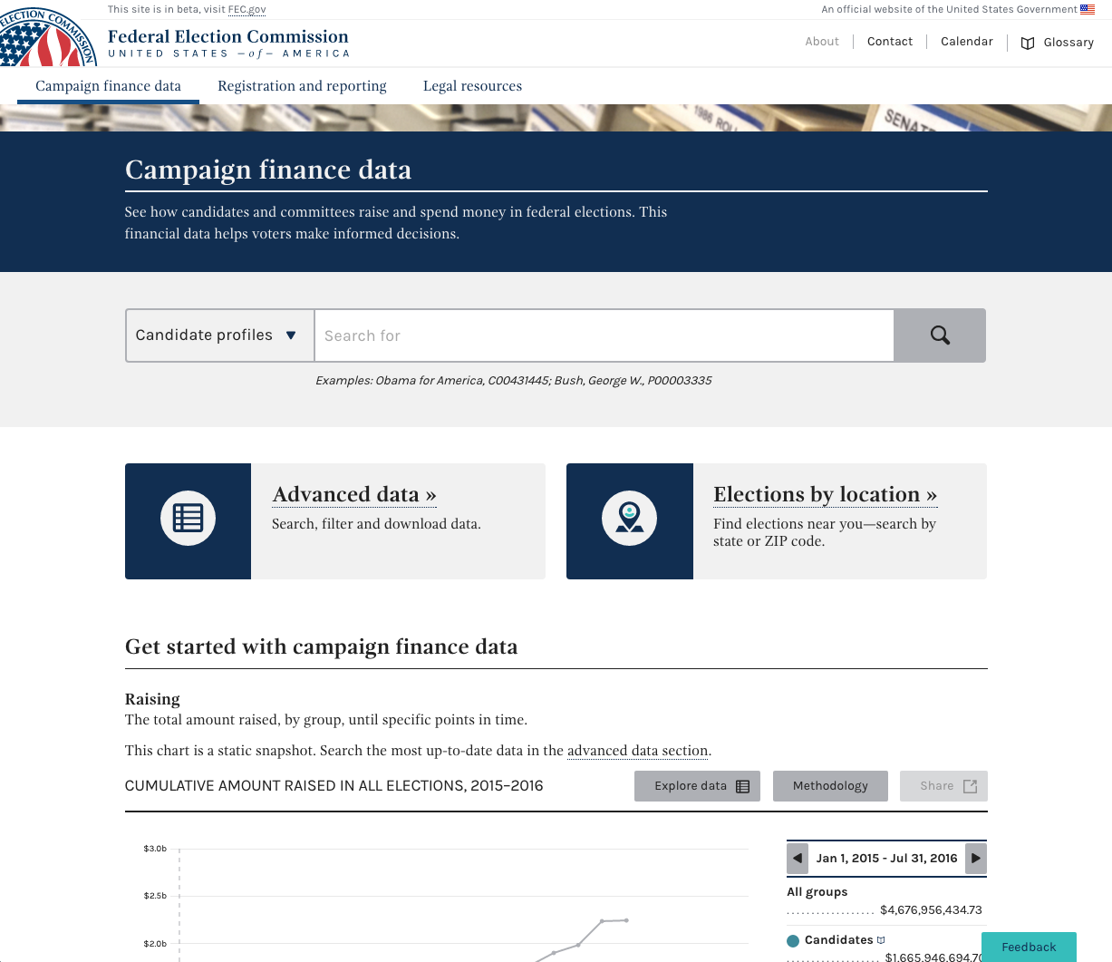

Slide 6
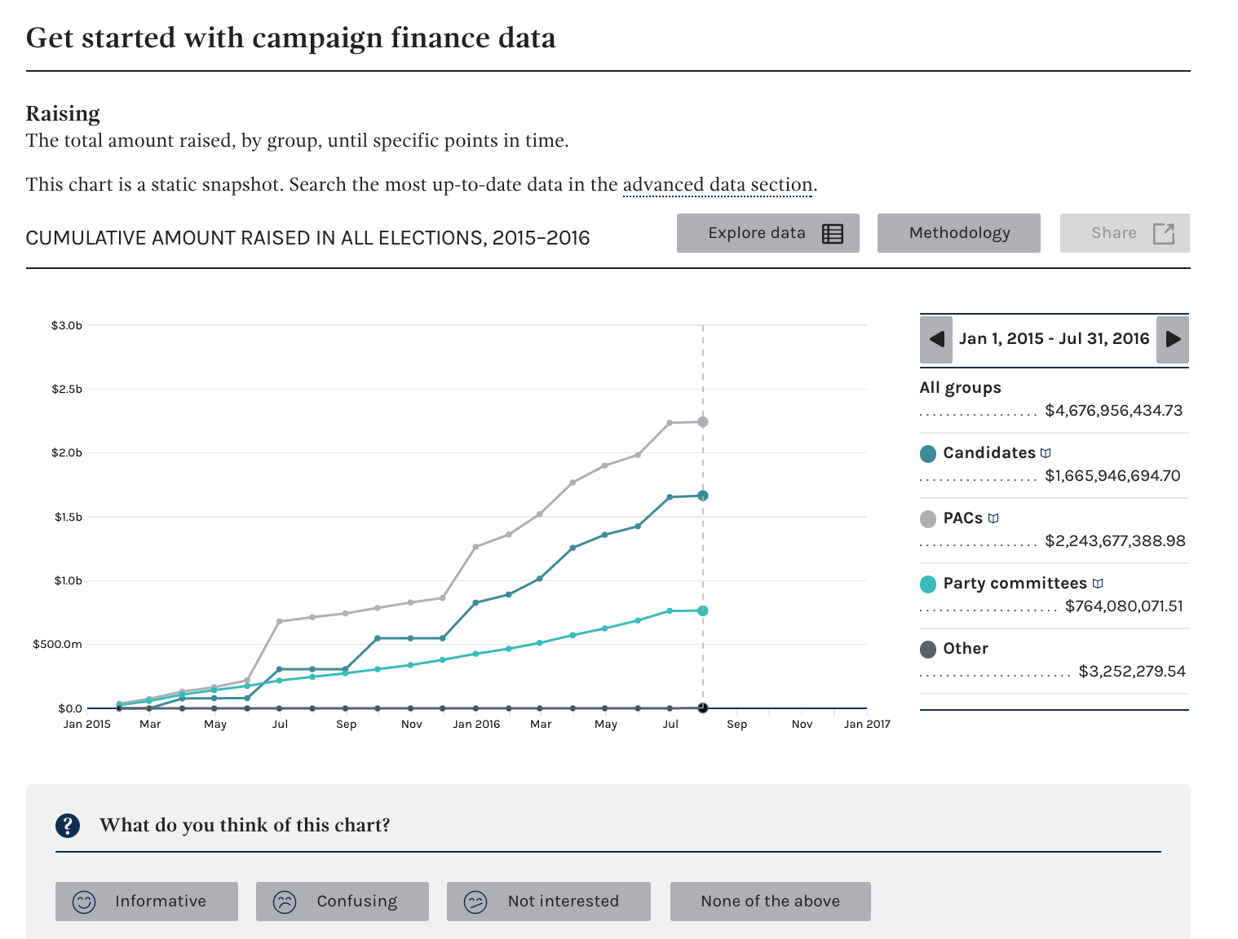

Slide 7
eRegulations
Open Data
Jen Ehlers, 18F

Slide 8
The regulatory process allows citizens to engage with and define the laws that govern them.
Few do. eRegs wants to fix that.
Notes:
Here is the problem as the eRegulations team sees it. I don't think this statement is too much of a surprise for anyone here. The regulatory process is hugely important and the mechanisms by which citizens are able to engage are difficult and not widely understood.

Slide 9
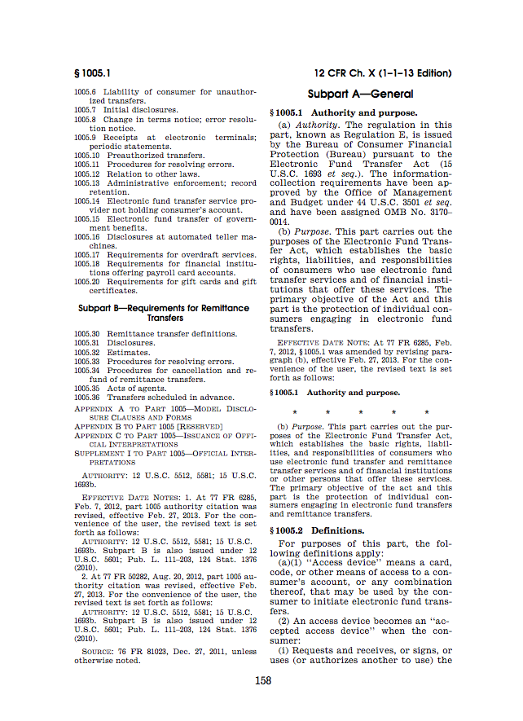
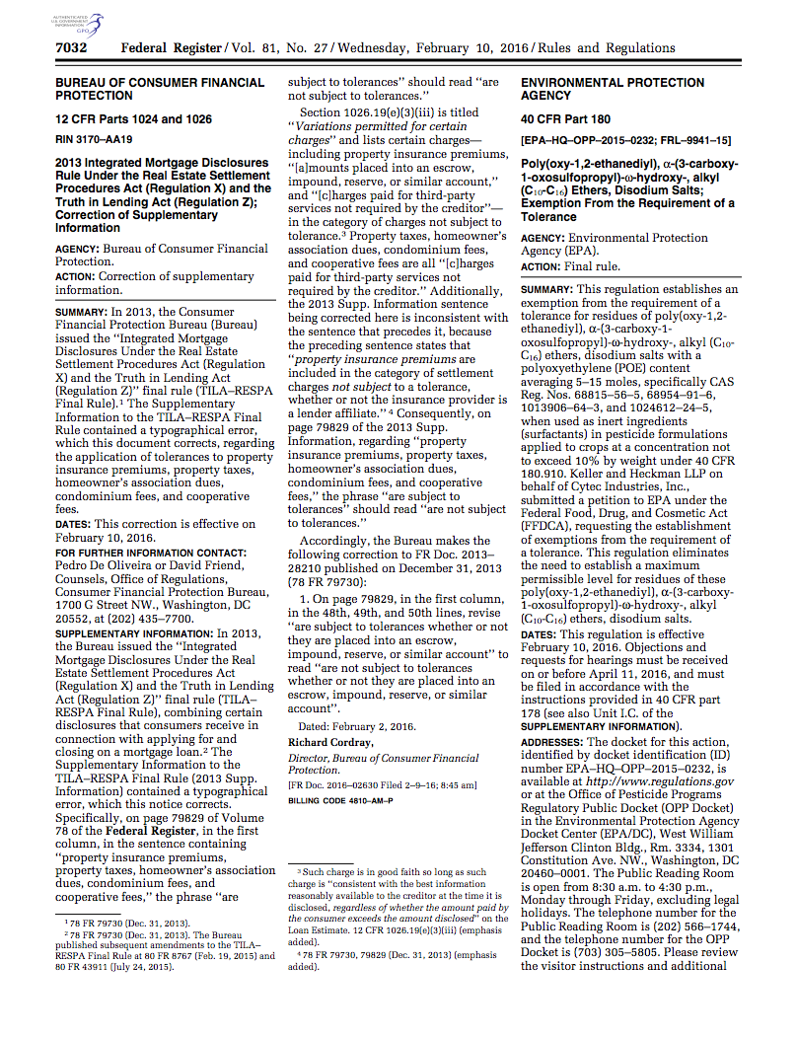
Notes:
These dense PDFs are what people have to sort through in order to understand how to comply with the law and do whatever it is they want to do. The eRegulations team saw an opportunity to present this already structured text in a better way.

Slide 10
Section 3
Plain Text
3(a)
3(a)(1)
3(a)(2)
3(b)
Notes:
We needed a parser to convert the plain text into full hierarchies. We’d use this parser to derive definitions, citations, etc.

Slide 11
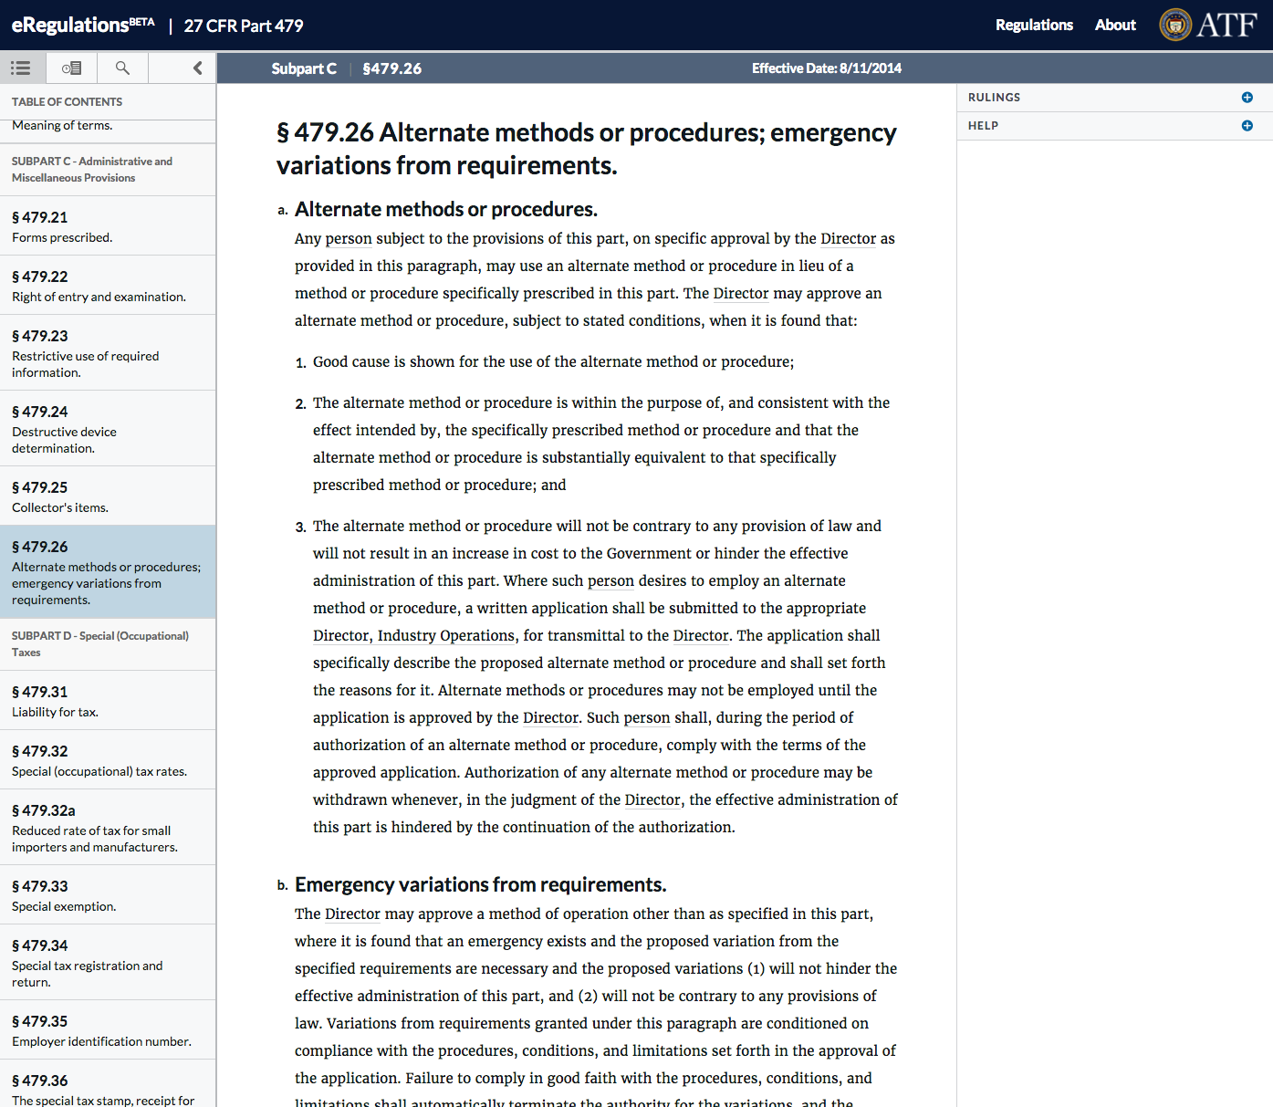

Slide 12





Slide 13
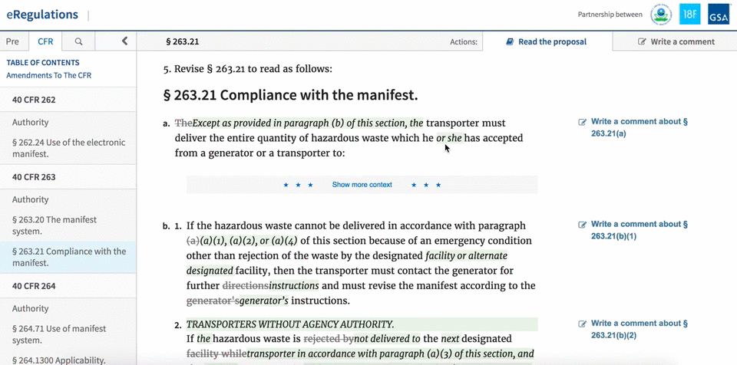
Notes:
So, we created a platform that makes finding, reading, and understanding regulations easier. But what you see here is the newest feature, something we are piloting as we speak. The exciting part of the regulatory process is the built in feedback cycle. As agencies change regulations over time, they open up their suggested changes for comments from the public. We’re trying to make that process generally more accessible by presenting the text in a format that is easier to navigate, read, and skim, and allowing users to comment on any section down to the paragraph level. Our hypothesis is twofold:
1) By presenting the proposed rule in the context of the changing regulation, we will make it easier for commenters to understand the changes and better explain their views. Therefore, lessening the contextual burden on the public.
2) By providing agencies with more context as to what parts of the rule comments relate to, we will make their job of sorting the comments easier and faster. Therefore, lessening the contextual burden on agency staff.

Slide 14
Notice & Comment pilot:
epa-notice.usa.gov
eRegulations platform:
eregs.github.io

Slide 15
Thank you!
For further discussion: jennifer.ehlers@gsa.gov or will.sullivan@gsa.gov

